Slide 1
Great Outdoors
Group A
- Sourav

Slide 2
Great Outdoors - Use Case Diagrams

Slide 3
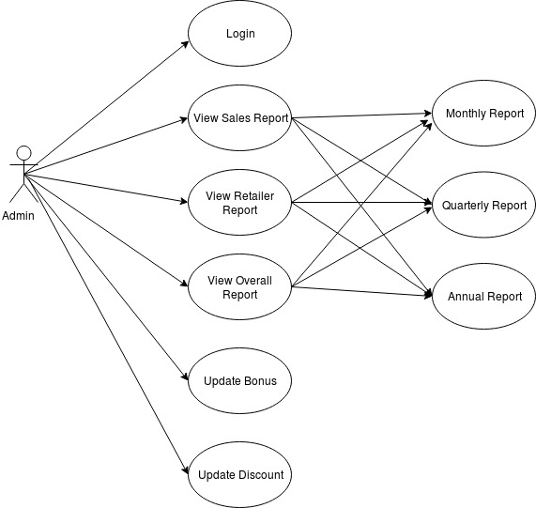
Great Outdoors – Use Case Diagram for Admin

Slide 4
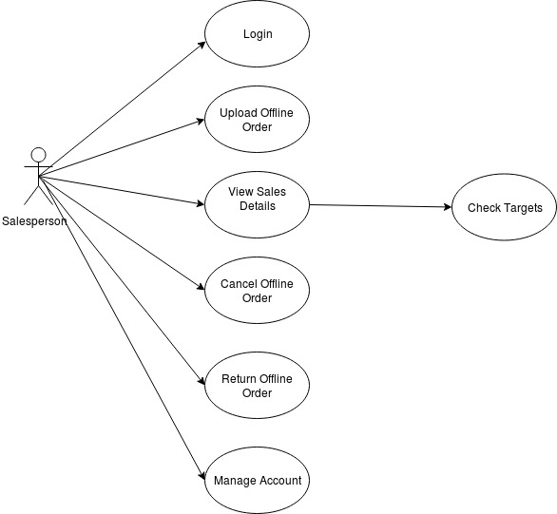
Great Outdoors – Use Case Diagram for Salesperson

Slide 5
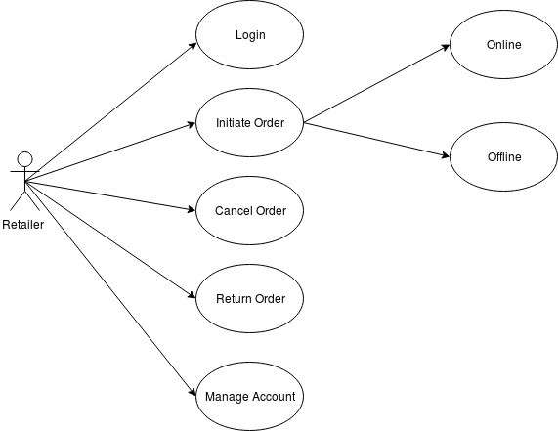
Great Outdoors – Use Case Diagram for Retailer

Slide 6
Great Outdoors - Class Diagrams
(Return and Specification)

Slide 7
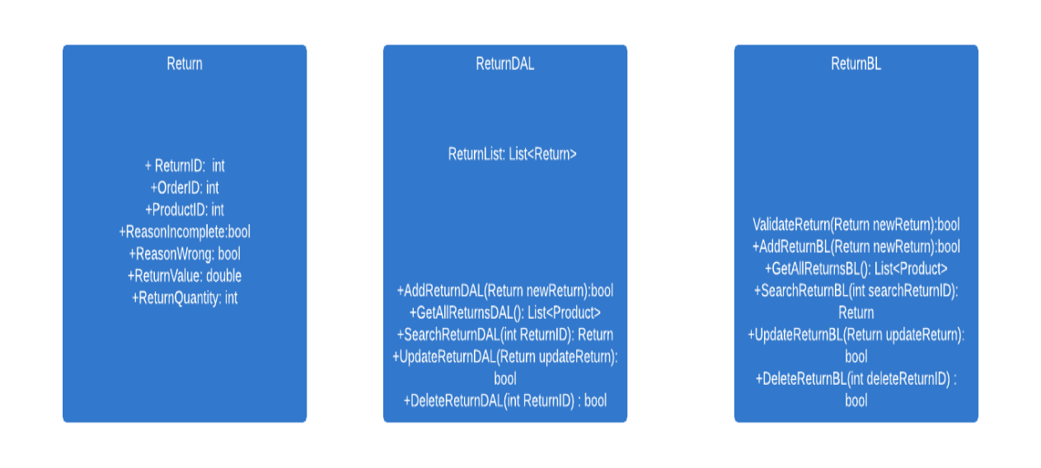
Great OutdoorsClass Diagram For Return

Slide 8
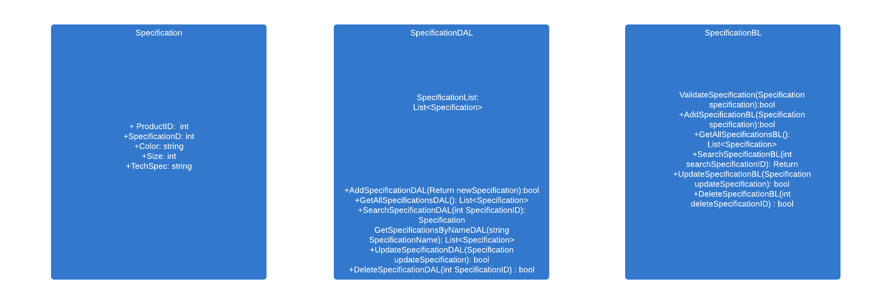
Great Outdoors - Class diagram for Specification

Slide 9
Great Outdoors - Sequence Diagrams
(Return and Cancel Online Order, Change Product Specification )

Slide 10
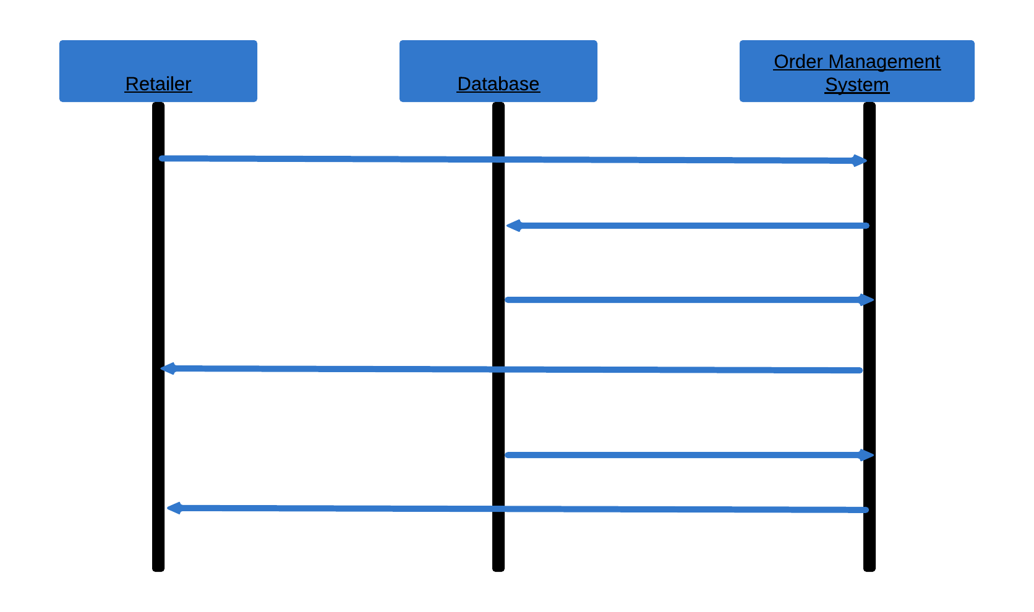
Sequence Diagram – Return Order Online
Request Return Online
Check if Return Period is over?
If YES
Return NOT Possible
If NO
Return Confirmation

Slide 11
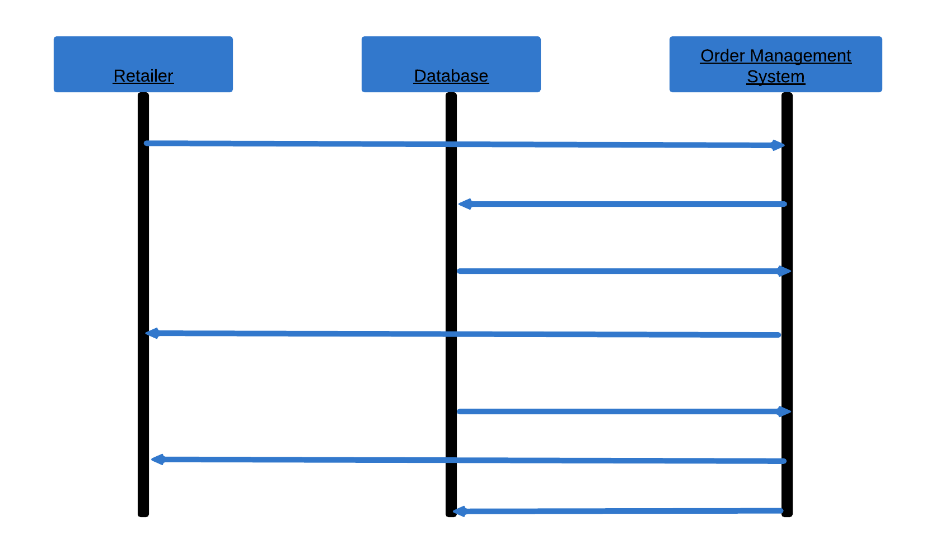
Sequence Diagram – Cancel Order Online
Request Cancel Online
Check if Cancel Period is over?
If YES
Cancel NOT Possible
If NO
Confirm Cancellation
Change Revenue Data

Slide 12
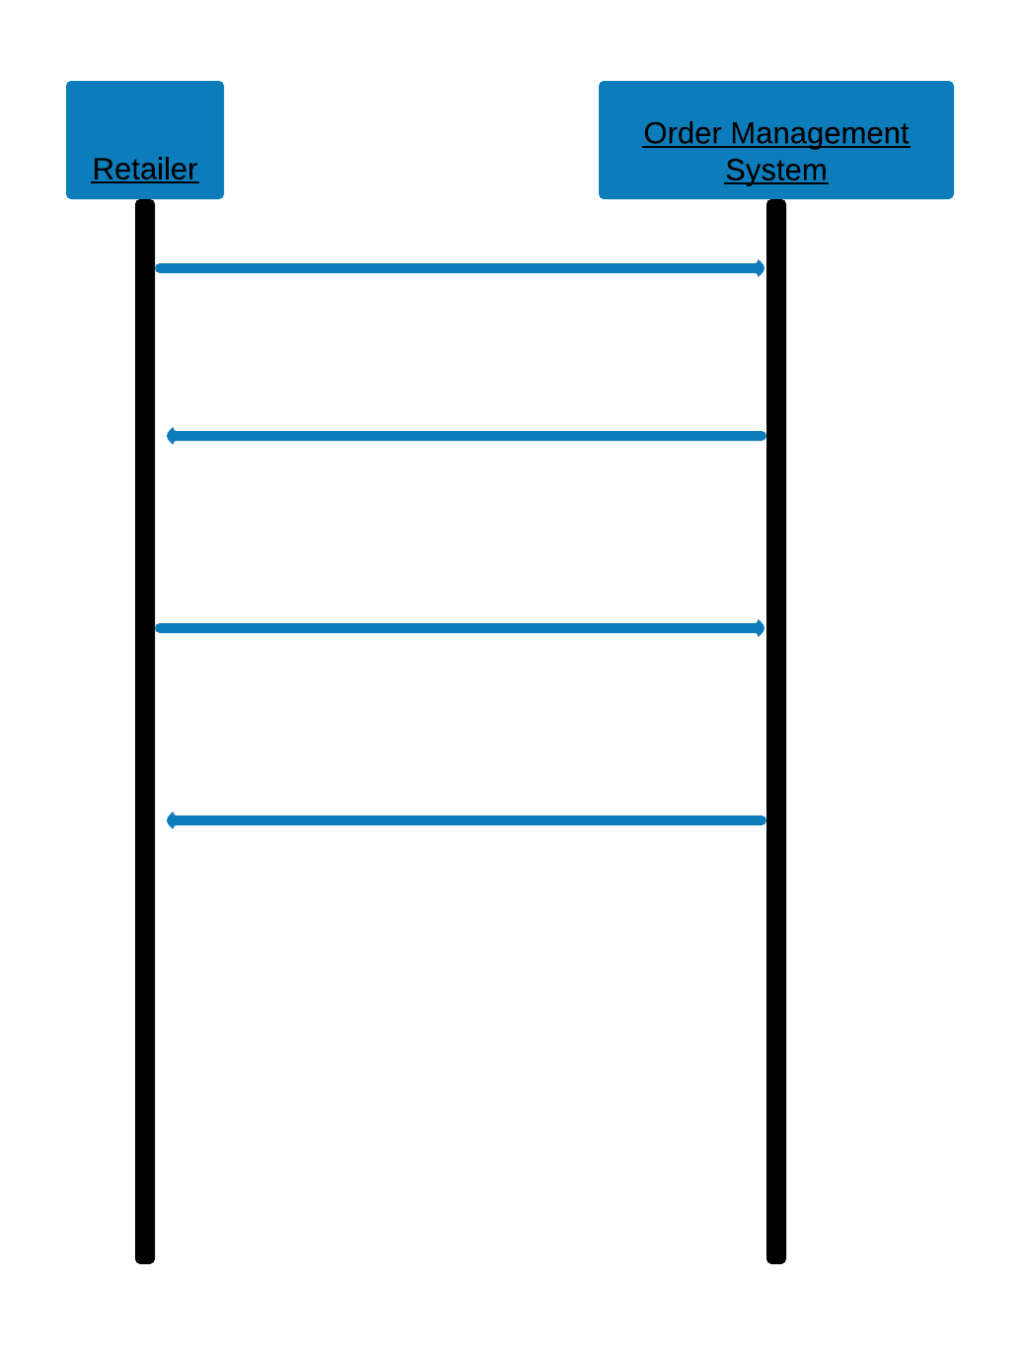
Sequence Diagram – Specification Change by Retailer
Select Product to Order
Ask for changing specifications
Changes specification
Confirmation sent

Slide 13
Great Outdoors – Epic and User Stories
(Return and Cancel Online Order, Change Product Specification)

Slide 14
Epic : Return of an Online Order
User Stories
User should be able to initiate a return process for a product she ordered.
User should be able to select a reason why she is returning the product (Incomplete product or wrong product delivered).
If the return period is over for the product, user should be diplayed a message that return is not possible.
If the return period is not over, user should be able to return the product.

Slide 15
Epic : Cancellation of an Online Order
User Stories
User should be able to initiate a cancel process for a product she ordered,but not yet delivered.
User should be able to select a reason why she wants to cancel the product.
If the cancellation period is over for the product, user should be diplayed a message that cancellation is not possible.
If the cancellation period is not over, user should be able to cancel the product and get her money back.

Slide 16
Epic : Change Specification of a Product
User Stories
User should be given a list of specifications to choose while selecting a product to order.
User should be able to change a specification of the product.

Slide 17
Thank You.

